Slide 1
INSTALLATION OF PIPES AND
CONDUITS WITHOUT DIGGING A
TRENCH
Naresh Koirala, P.Eng.,
Golder Associates Ltd.

Slide 2
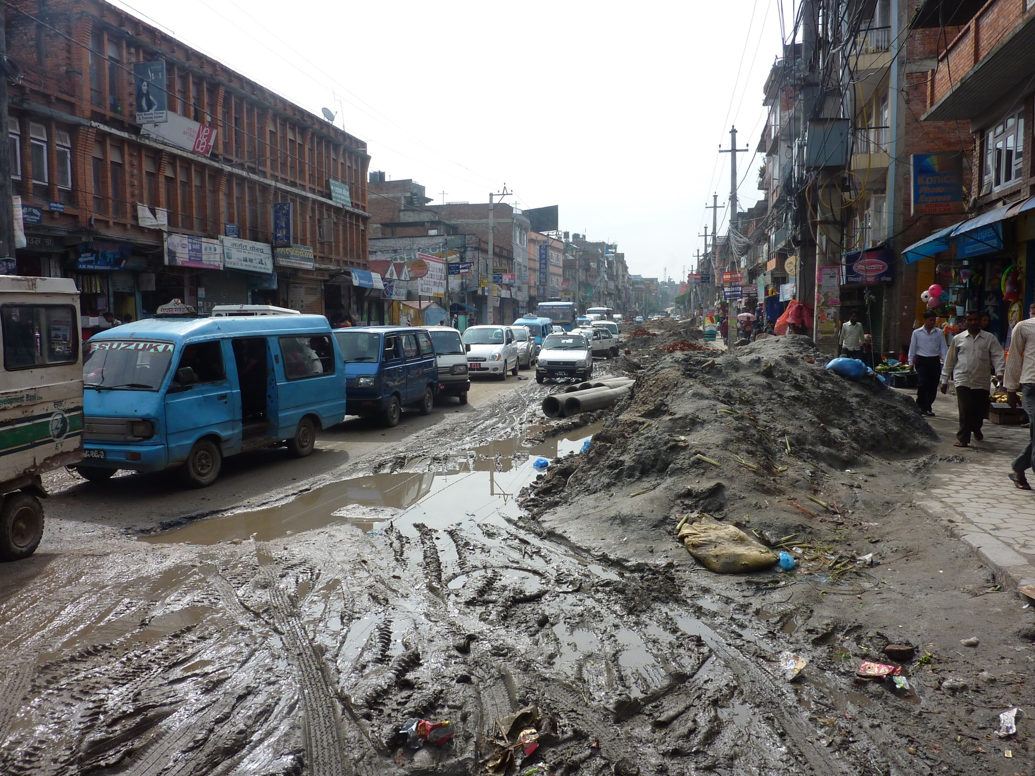

Slide 3
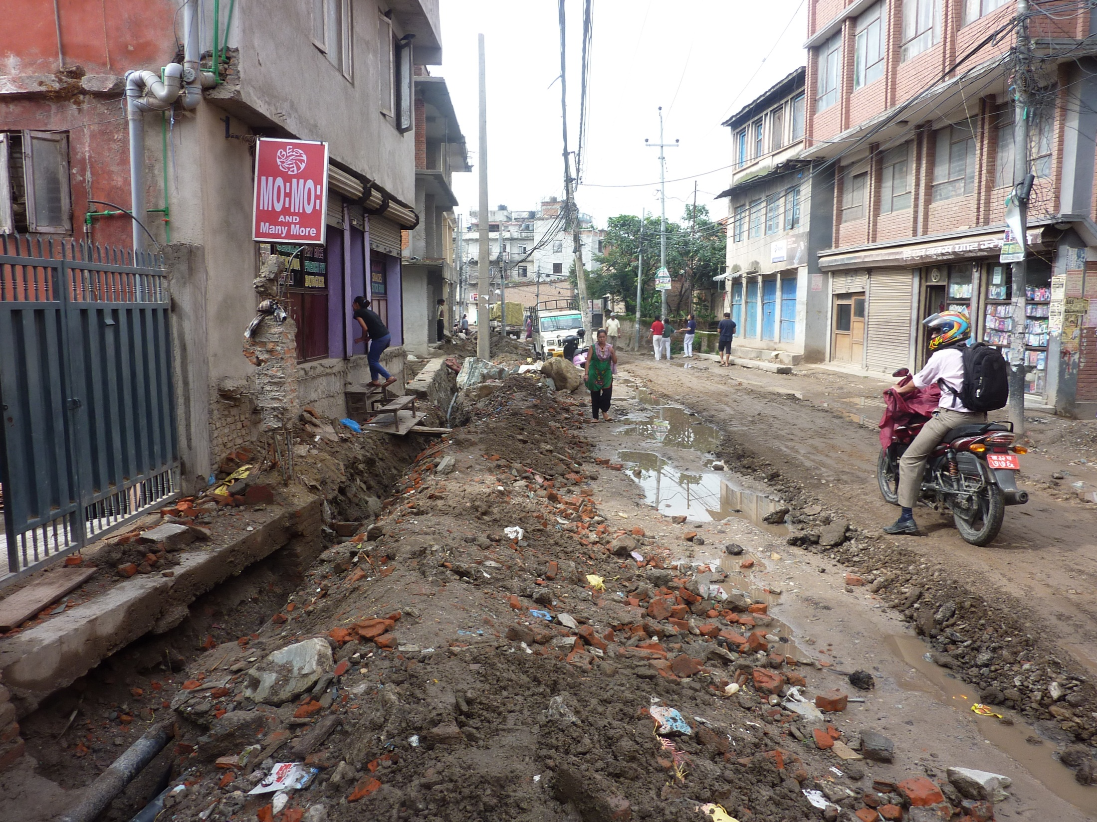

Slide 4
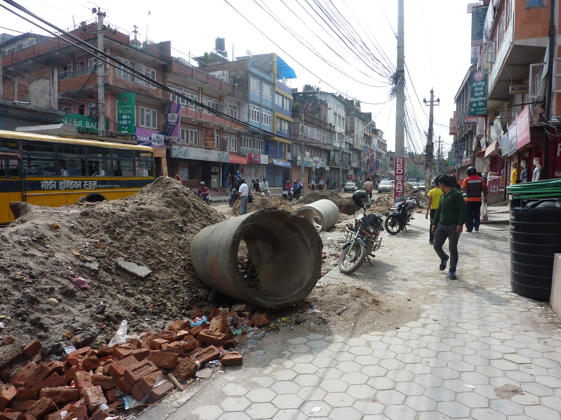

Slide 5
Presentation Outline
Growing Population and Demand For Pipe Lines
Renew Old Pipe lines/ Construct New Pipelines to meet demand
Traditional method of Construction
Why Trenchless?
Definition of Trenchless Methods
Type of Trenchless methods
New construction methods
Case histories

Slide 6
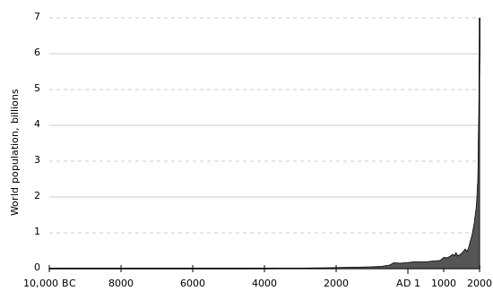
World Population Growth

Slide 7
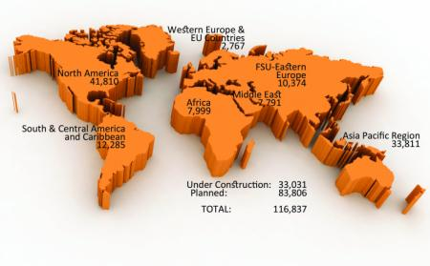
Ref: Pipeline & Gas Journal’s 2013 Worldwide Construction Report (Miles of Pipe Lines Planned/Cons

Slide 8
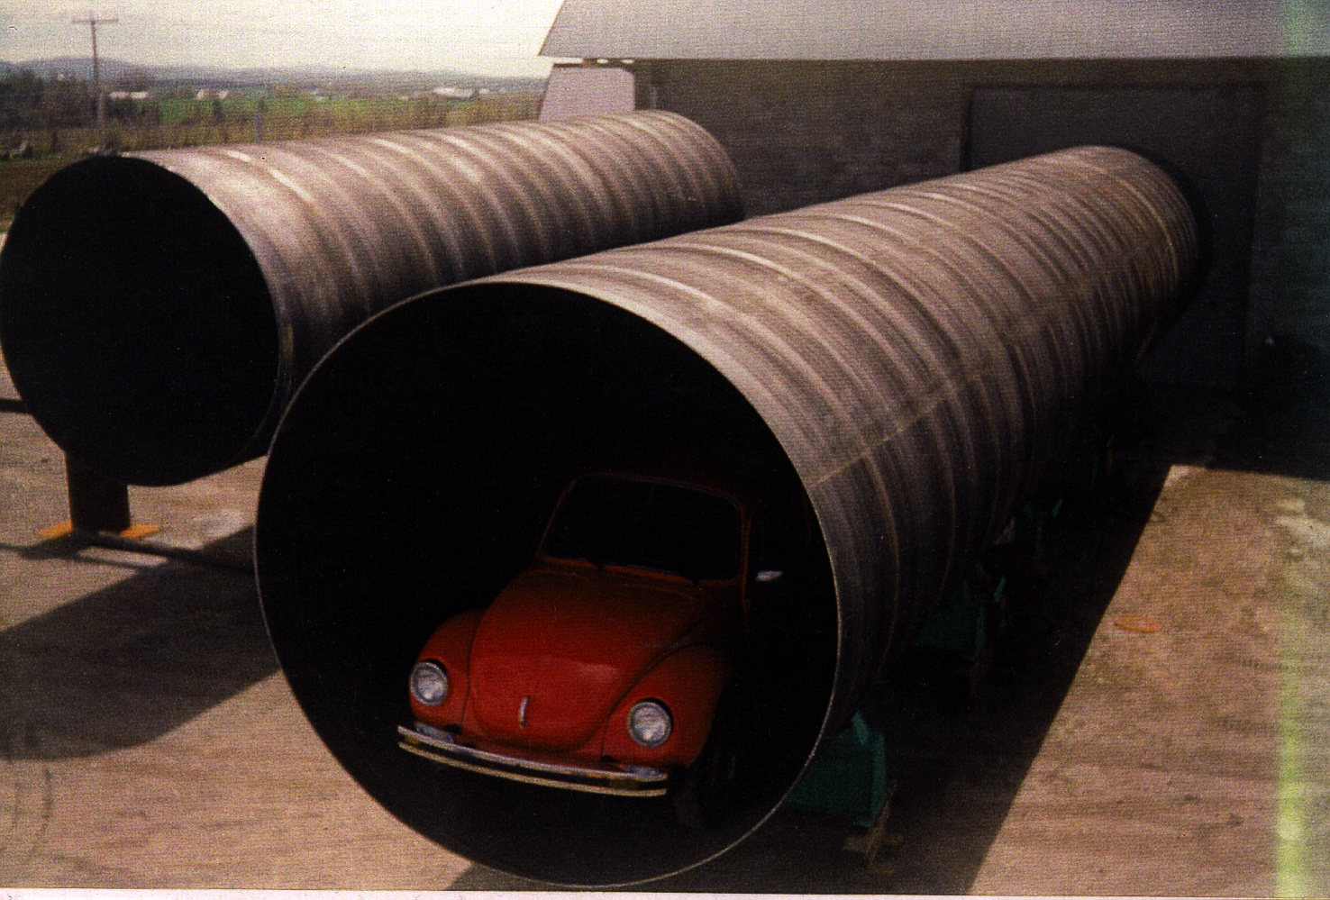

Slide 9
Cost of upgrading and New Construction of Pipe lines
US Data
  4 million Kilometers of pipe lines
  Cost to repair water and waste water system in 20 years
    $ 600 Billion to 1 Trillion

Slide 10
Method of Construction
Traditional Method : Open Cut
New Method : Trenchless

Slide 11
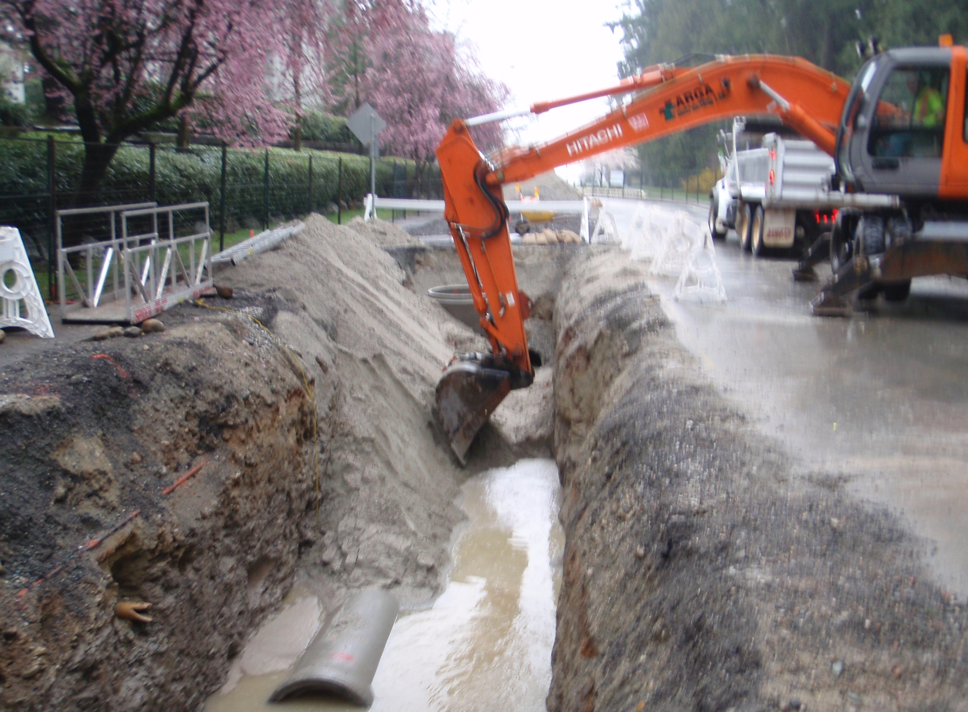

Slide 12
Open Cut
Asphalt
Road base
Import backfill
material
Native Soil
Native soil
(Open cut to
Install pipe)
Open cut area
Surround bedding
Zone affected when
pipe is installed by
Trenchless method
Installed Pipe

Slide 13
Open Cut
Traffic Disruption
Social Cost
Environmental cost
Green House Gas
Not always cost effective
Not a feasible option

Slide 14
Fuel Consumption vs. Speed

Slide 15
ILLUSTRATION OF TRENCHLESS AND OPEN CUT METHODS
Trenchless Method
Conventional Open Cut Method
Asphalt
Road base
Import backfill
material
Native undisturbed
soil
Native soil
(Open cut to
Install pipe)
Open cut area
Surround bedding
Zone affected when
pipe is installed by
Trenchless method
Installed Pipe

Slide 16
Trenchless
Environmentally less disruptive
Cost effective under many situations, particularly if environmental, social cost is accounted.
No other suitable method.
This is what public wants.

Slide 17
Definition
"A variety of non-disruptive techniques for installing, replacing or renovating underground pipes and cables without open-cut excavation"
(Term introduced in early 1980s,
accepted in construction industry)
James C. Thompson (1983)

Slide 18
Trenchless Methods
Pipe Renewal
Cured-in-Place Pipe
Thermoformed Pipe
Sliplining
In-line Replacement
  -Pipe Bursting
  -Pipe Replacement
Pipe Removal
(ref: ASTM F-1216- “Standard Practice for Renewal of Existing Pipelines and Conduits by the Inversion and Curing of Resign Impregnated Tube)
New Installation
Pipe Jacking
Microtunnelling
Pipe Ramming
Horizontal Directional Drilling
Tunnelling
Guided Auger Boring /Pilot Tube Tunnelling

Slide 19
Pipe Rehabilation

Slide 20
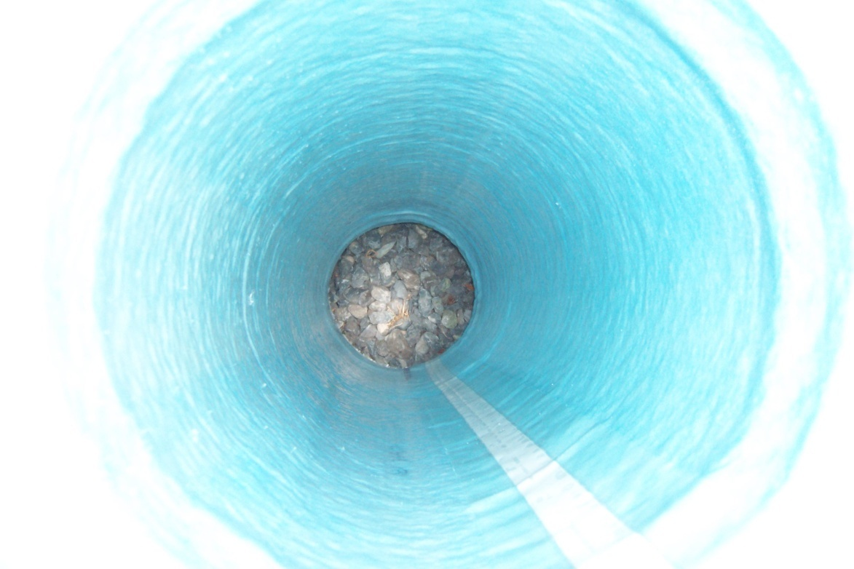
Flexible resin-impregnated tube installed into an existing pipe then cured to a solid finish – new pipe in an old.
Notes:
Felt or fiberglass tube holds resin until it is in place.
Cured (heat, steam, pressure, light)
Structurally – comment that the host pipe must be in well enough shape to survive the CIPP process.
Often used to renew a damaged pipe.
Cost about 1/3 of open cut construction for the same job.

Slide 21
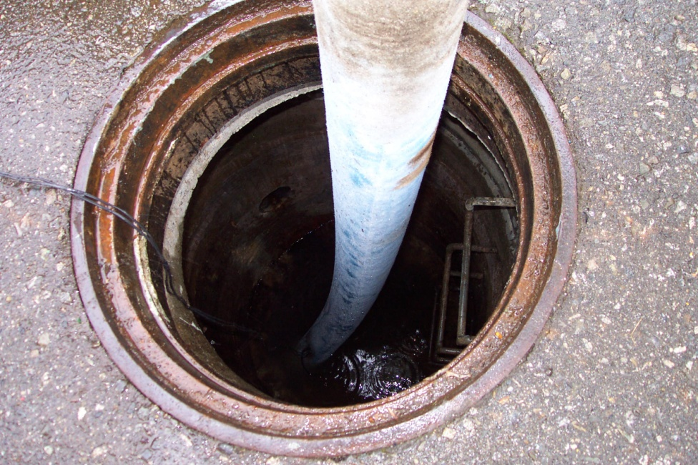
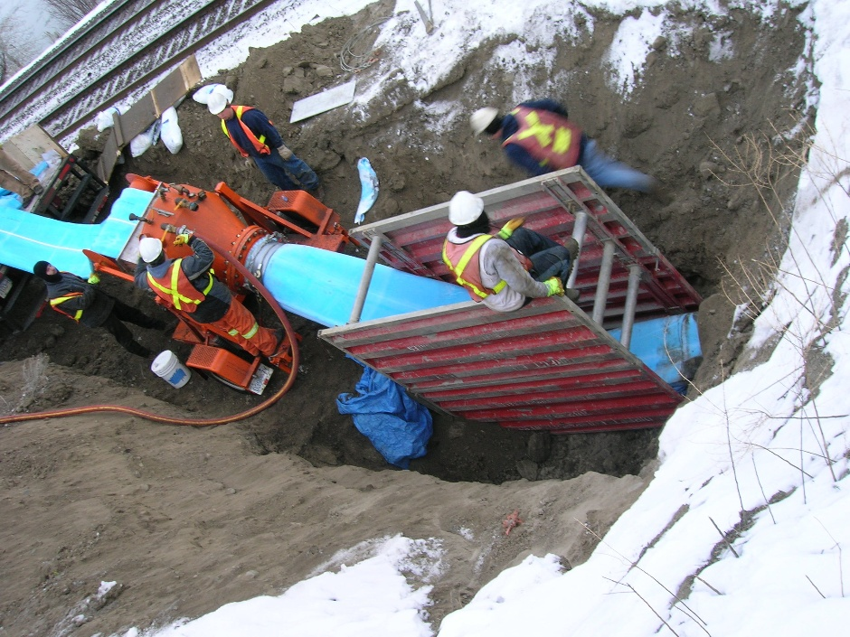
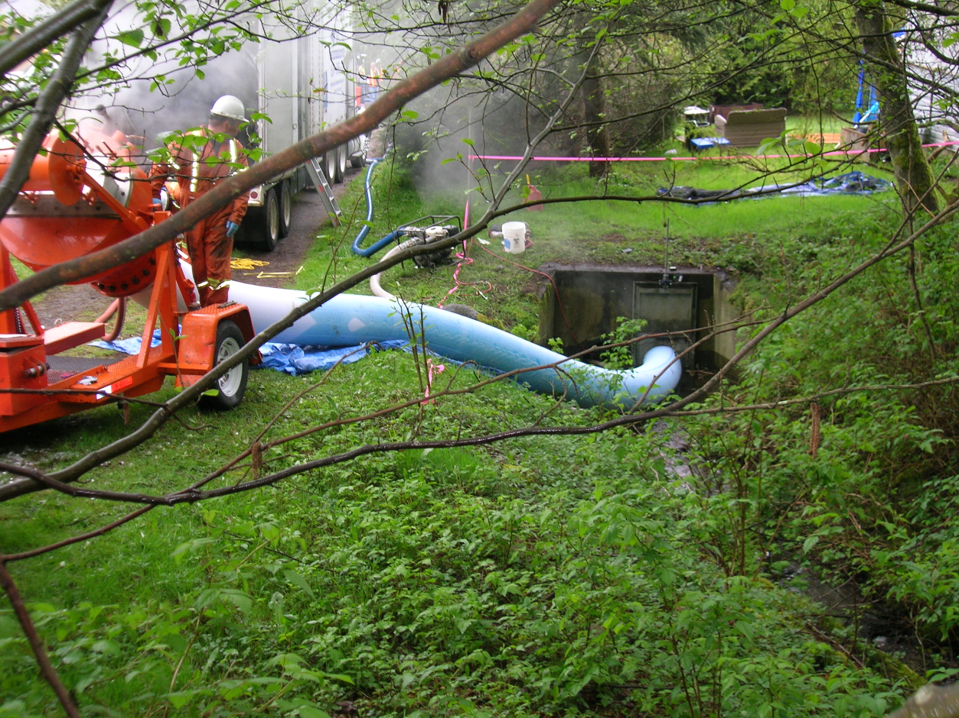
CIPP
Notes:
You can install through;
A pit,
A MH or,
A head wall.
Often residences don’t even know it’s happening.

Slide 22
THERMOFORMED PIPE
  -Fold and Form (PVC)
  -Deformed and Reformed (HDPE)
  -Fused and Expanded (PVC)

Slide 23
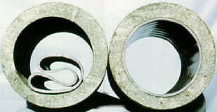
Deformed and Reformed Pipe
Plastic pipe(PVC) is folded, pulled into an existing pipe then expanded to form a tight fit structural liner.
A new pipe inside the old pipe.

Slide 24
Slip Lining
Used to repair leaks or restore structural integrity to an existing pipelines
Install a smaller pipe in the host pipe; grout the annulus and seal the ends.

Slide 25
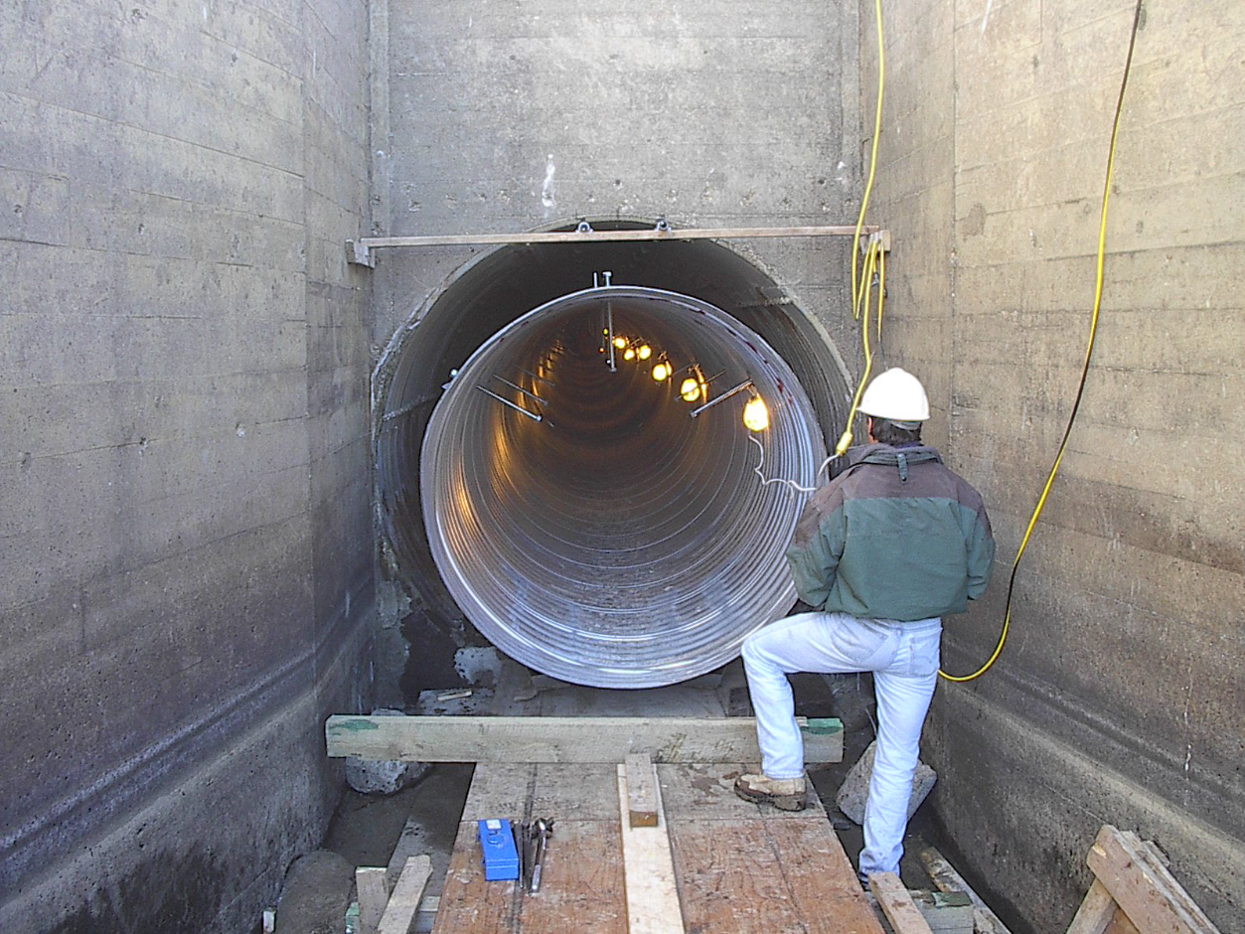

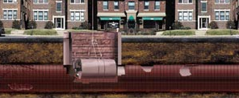
Slip Lining
Lining with a new pipe that fits close to the existing pipe.
Notes:
Can be performed while the line is live.

Slide 26
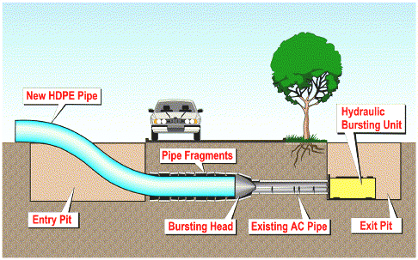
Pipe Bursting

Slide 27
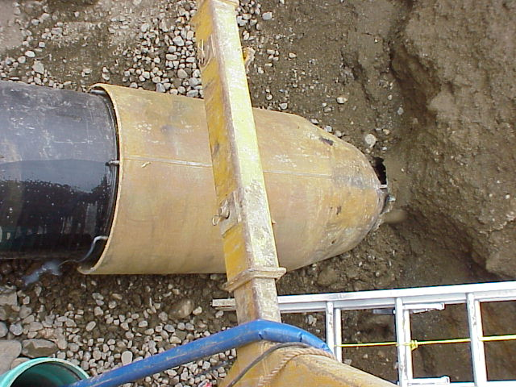
Upsizing

Slide 28
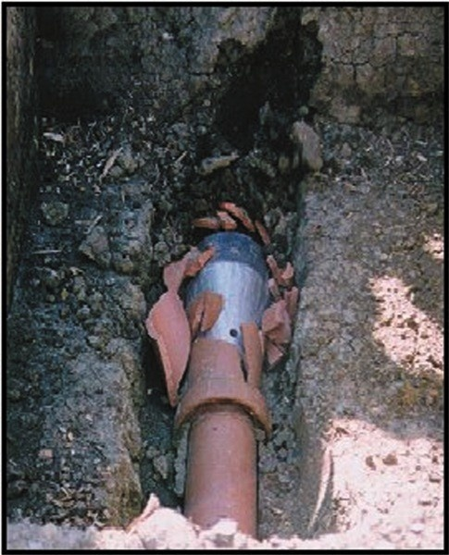
Pipe Bursting

Slide 29
New Installations

Slide 30
PIPE JACKING

Slide 31
Pipe Jacking
"A technique of installing pipes
by driving a line of them through
ground with hydraulic rams from
a prepared jacking pit "
circa 1983

Slide 32
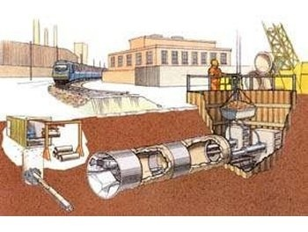

Slide 33
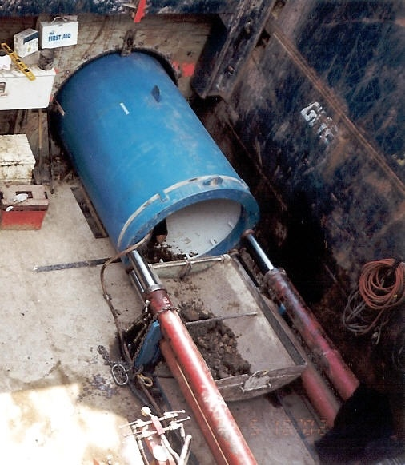

Slide 35
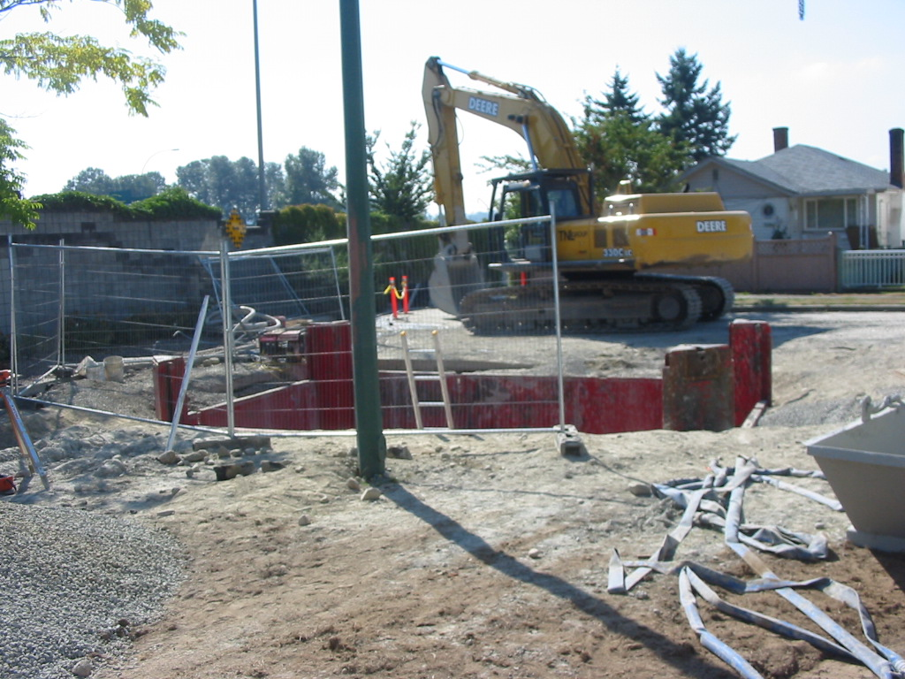

Slide 36
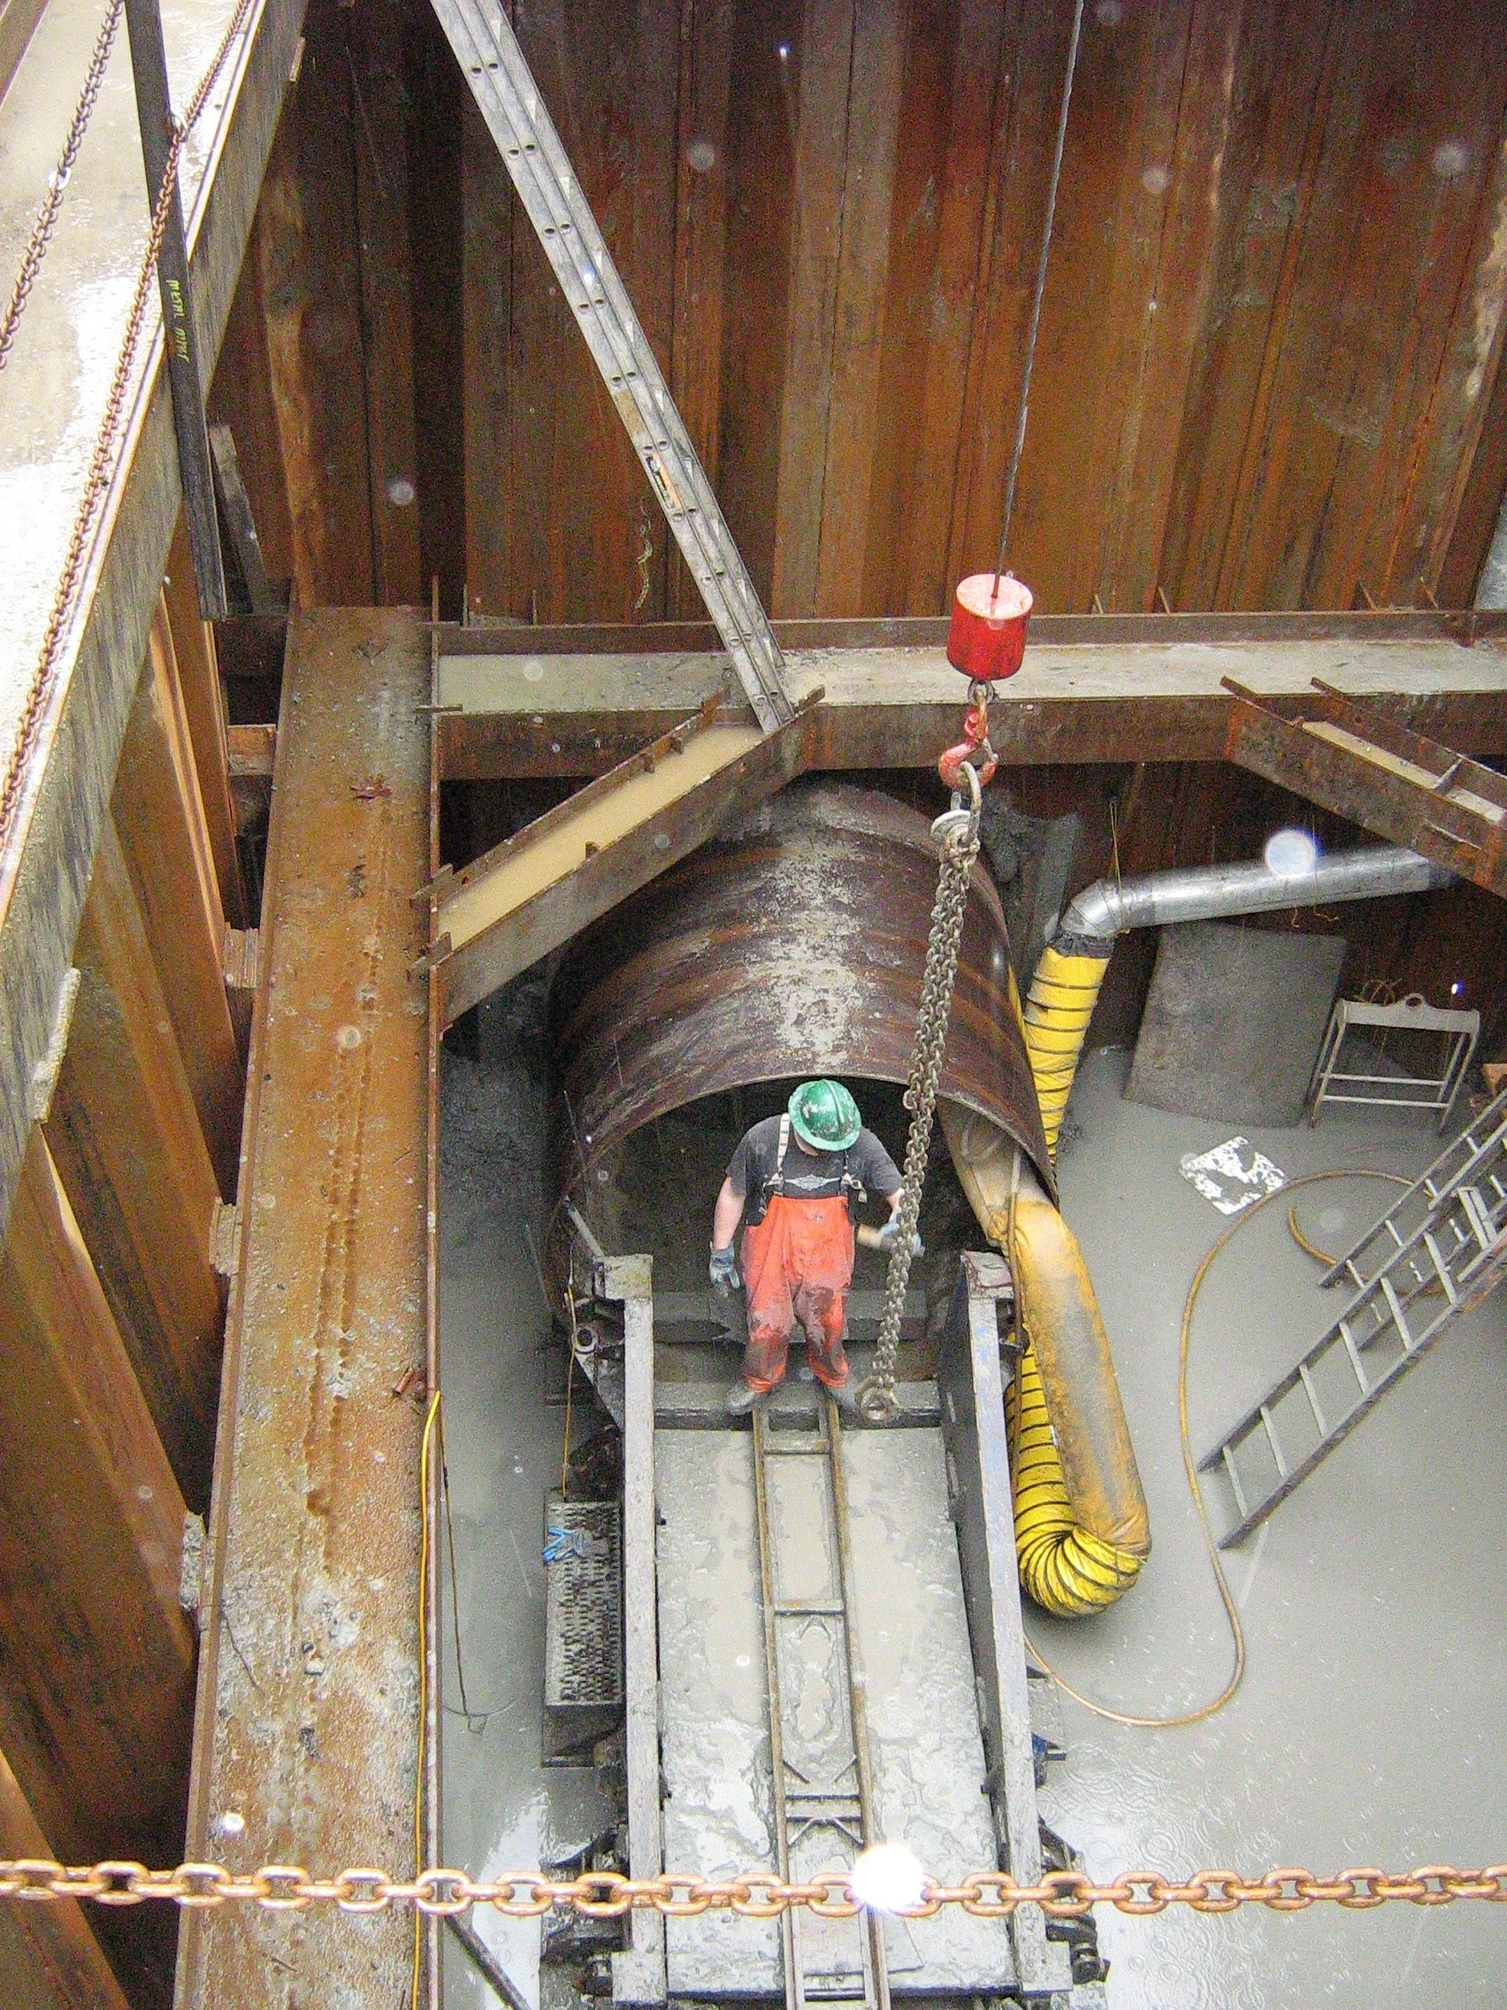

Slide 37
Horizontal Directional Drilling
(Vancouver City Central Transmission)

Slide 38
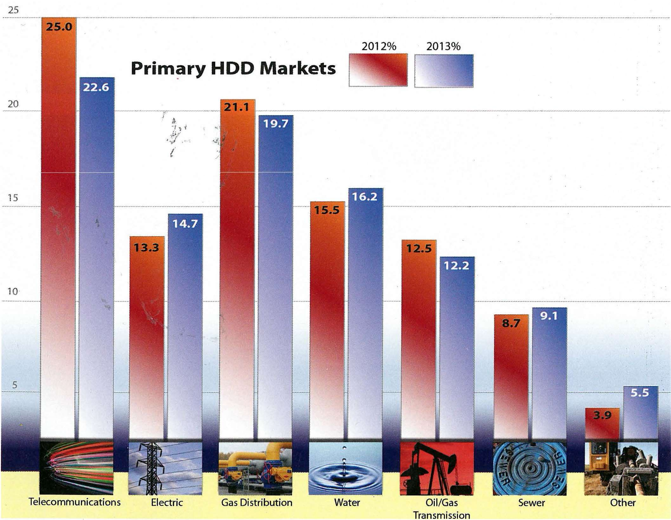

Slide 39
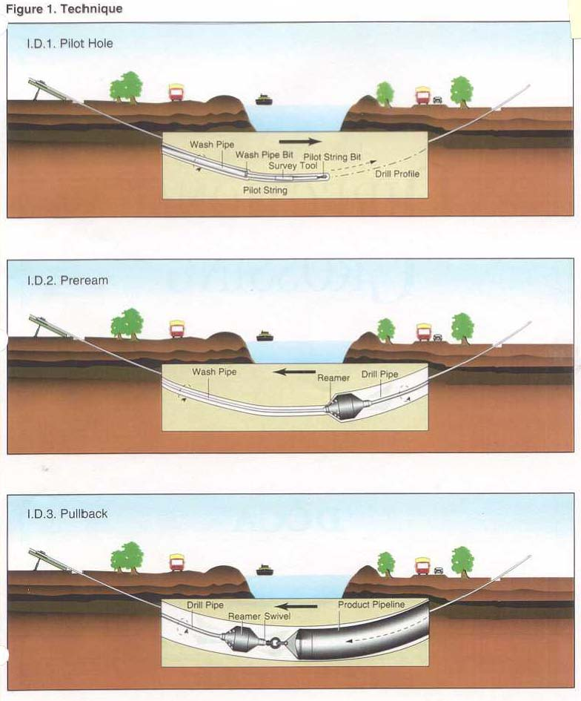
Technique

Slide 40
Video

Slide 41
Vancouver City Central Transmission

Slide 42
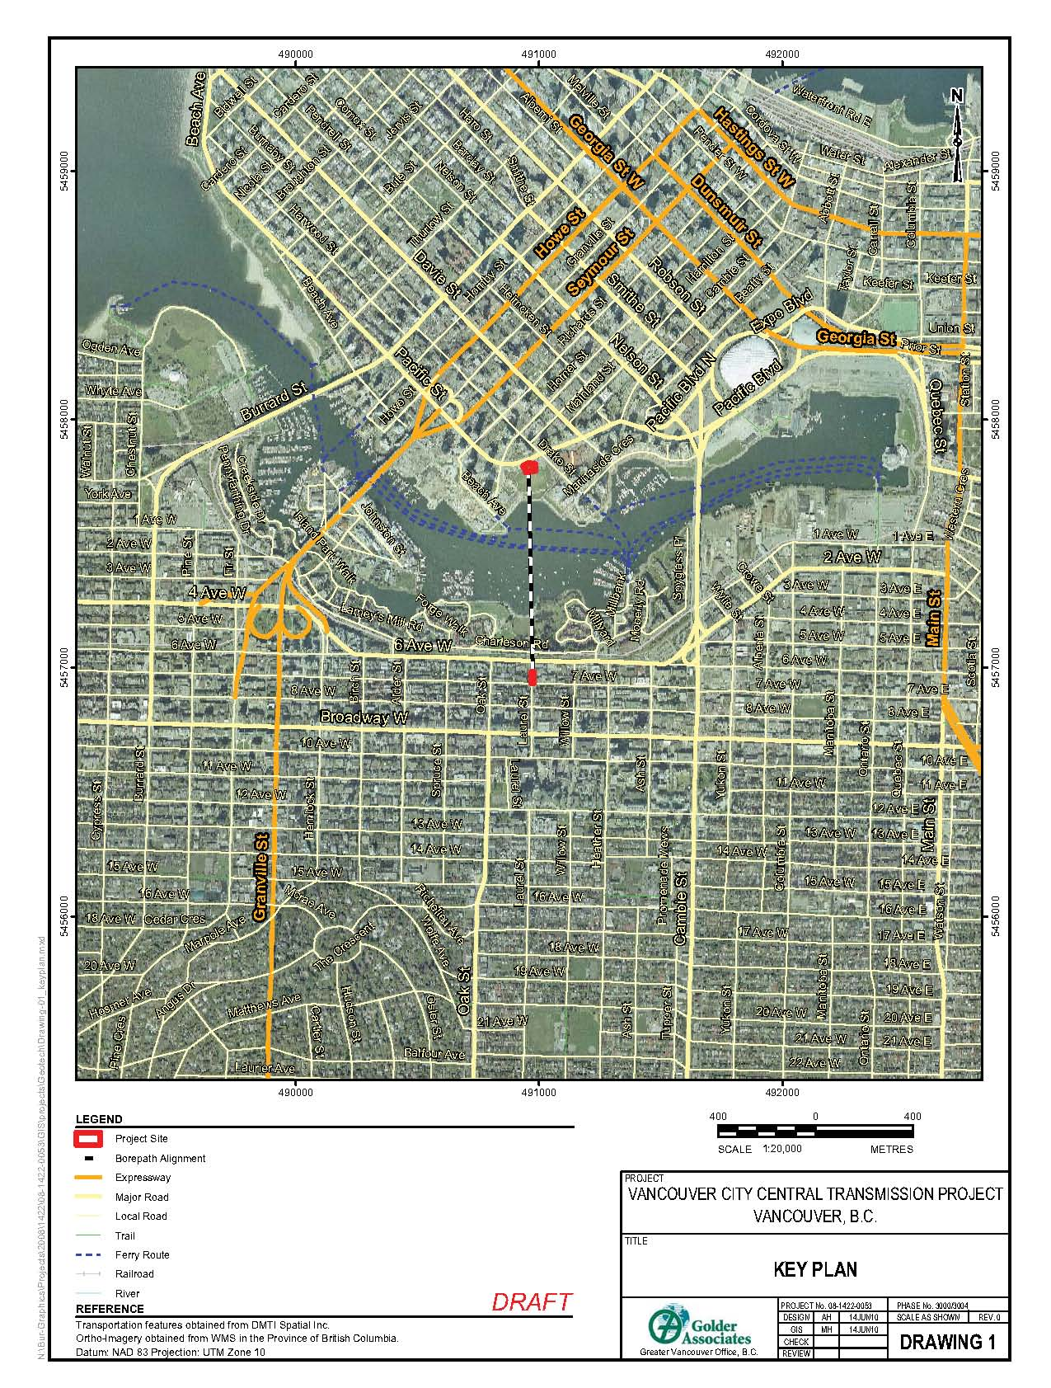
Location

Slide 44
Project
Install a bundle of 5- 10 in. and 10-
4 in Diameter pipes under False
Creek to house electrical cables

Slide 45
Scope Of Work
Geotechnical
  Site investigation
  Trenchless Options study ; identify and design preferred option
  Preparation of Technical Specifications
  Tender Evaluation
  Site Inspection and contract management assistance including evaluation of claims
Environmental and Archeological

Slide 46
Design Requirements/Challenges
  Seismic Reqirements
  Short construction duration
  Less Public Impact
  Thermal dissipation
  Tight entry/exit
  work areas

Slide 47
HDD Preferred Option
Risks:
    No prior experience in HDD through Vancouver’s glacial soil which includes cobbles and boulders;
    No prior experience in annulus grouting to the extent and scale required; Thermal heat dissipation grouting may not be successful;
    Maintaining banding during pullback may not be successful;
    Pipelaydown/pull back area tight with a number of 90 degrees bends;
    All works in noise/traffic sensitive downtown core.
Risk Mitigation:
    Prove drillability by drilling an exploratory hole through till;
    Pre design grout and execute field trial of installation;
    Dummy pull back;
    Several iterations to find a suitable route;
    Careful public relations; get public involved in the project.

Slide 48
Summary of Work Required
HDD drill spanning 850 m feet with an ultimate reamed diameter of 1180 mm;
Design HDD Borepath
Design HDD Bundle;
Design Grout mix;
Design Grouting Trial;
Pullback of 870 mm overhall diameter banded HDPE bundle;
Execute grouting field trial;
Complete grouting of the annulus between product bundle and the bored hole with thermal grout.

Slide 49
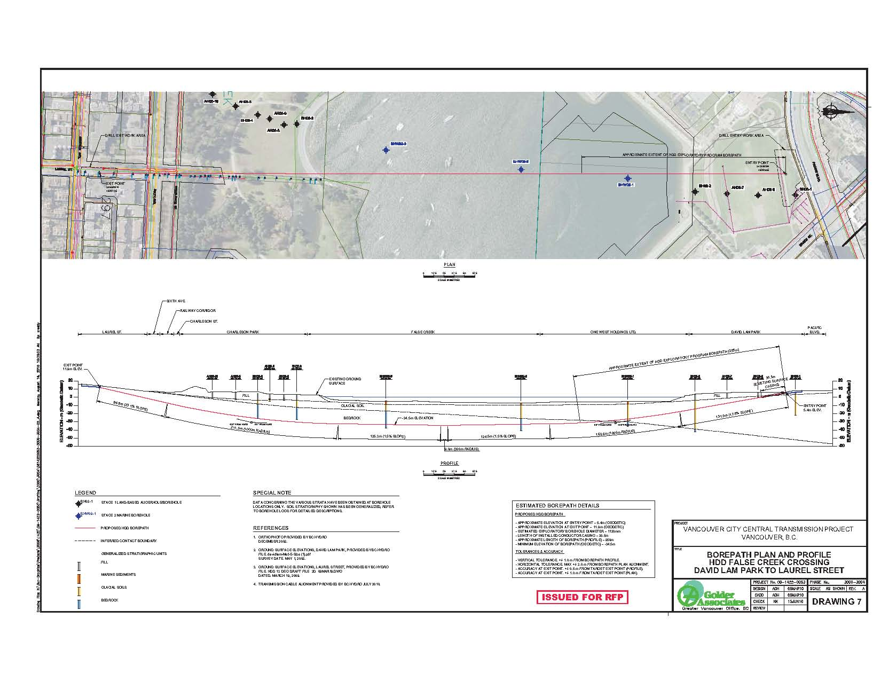
HDD Borepath

Slide 50
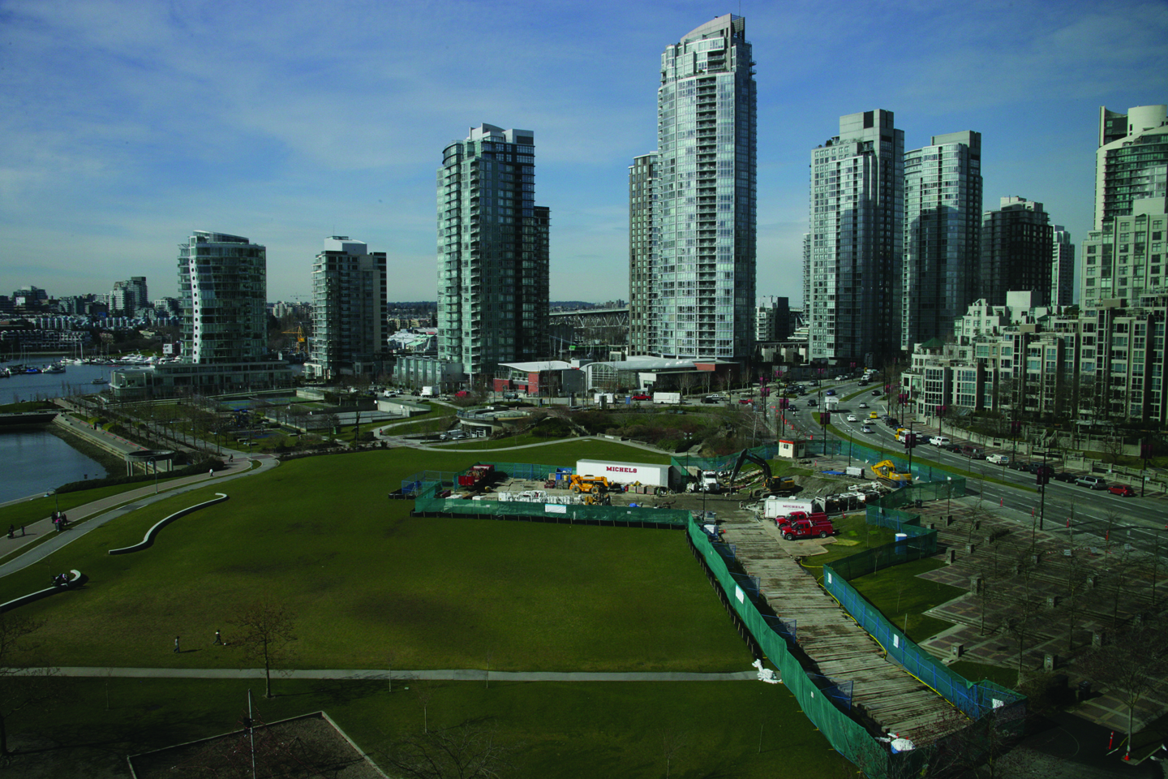
HDD – Entry Site
Located in David Lam Park in downtown Vancouver
Very active location
  20,000 residents within a
  two-block radius of the park;
  Highly utilized park;
  Adjacent to school and
  daycare.

Slide 51
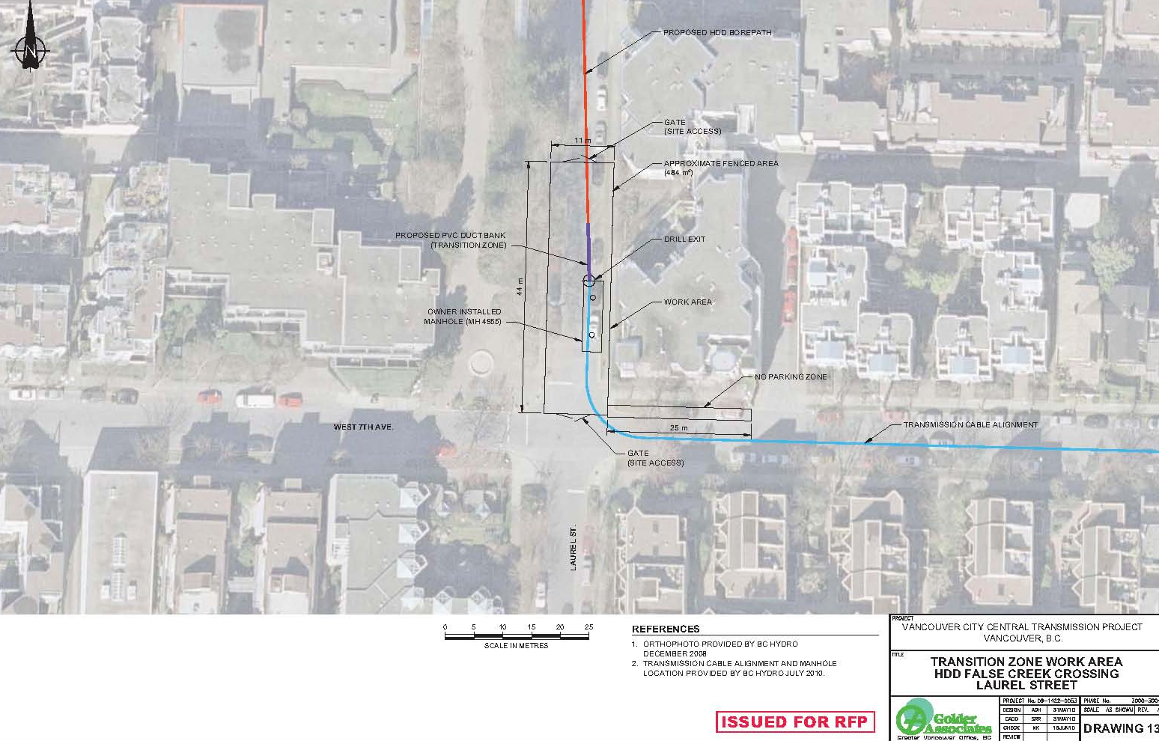
HDD – Exit Site
High-density residential
area on the south side
of False Creek
Evident impact to
residents
Very tight work area

Slide 54
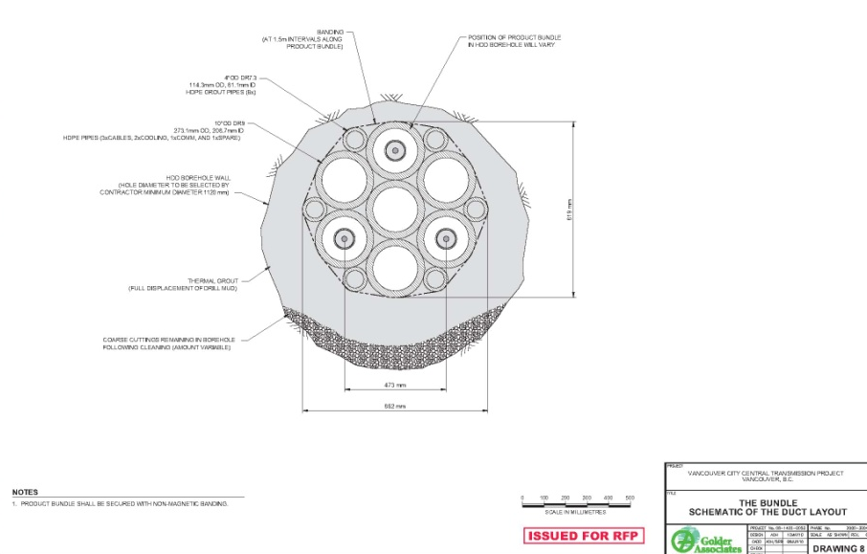
Bundle Design*
Seven 10-inch DR 9 HDPE Lines
(Electrical conduit)
Ten 4-inch DR 7.3 HDPE
(Grout lines at varied lengths)
A 5-inch DR 9 HDPE Line
(Grout Line to the low point
of the borehole)
All the lines were banded
together using half-inch
wide stainless steel strapping
* Cable and communication conduit sizes specified by BC Hydro

Slide 55
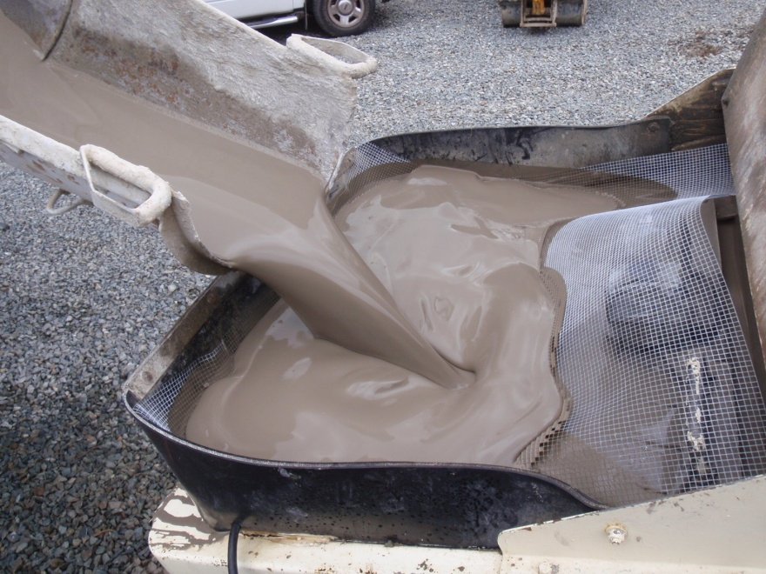
Thermal Grout
To meet thermal dissipation requirements, a thermal grout was needed that could be pumped through grout lines and used to displace drill mud from the borehole
Thermal grout was injected within bore hole after the product bundle was pulled into place
Suggested mix design meeting the requirements of thermal grout was developed by Constellation Group and Geotherm Inc.
Michels retained the services of Constellation Group LLC, a grouting company, to assist with the final design and planning of the thermal grouting portion of the project
Thermal Grout Mix Components:
    Silica Flour
    Cement
    Water
    Viscocrete 2110
    Sika 4R

Slide 56
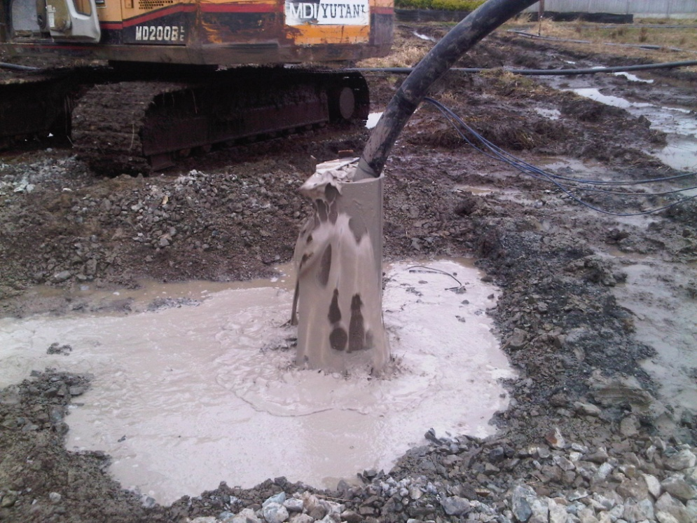
Grouting Trial (continued)
Vancouver Ready Mix supplied the grout
Drilled 50 m deep by 300 mm diameter circular hole and lined the hole with a steel casing
Once the hole was drilled and bottom grouting to stop migration of ground water complete, inserted three banded 4-inch HDPE DR7.3 lines into the cased hole
Drilling fluid was drawn directly from the mud tanks on site and pumped to the bottom of the hole
Grout was pumped through one of the lines until all the drilling fluid was displaced out of the hole

Slide 57
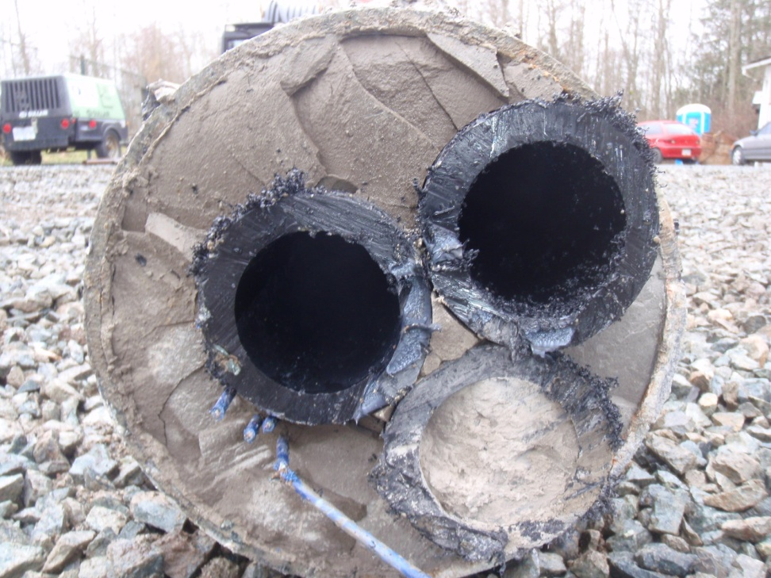
Grouting Trial (continued)
Full displacement was achieved with the trial grouting
Grout strength at 28 days exceeded 35 MPa

Slide 58
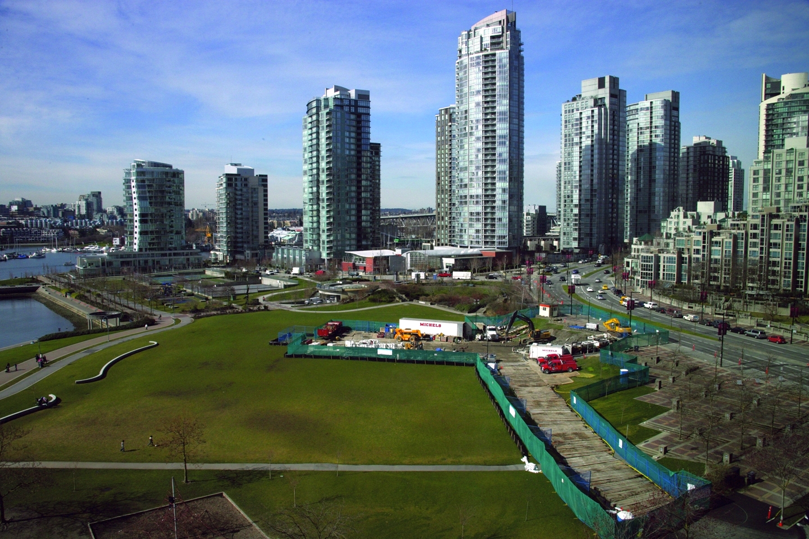

Slide 60
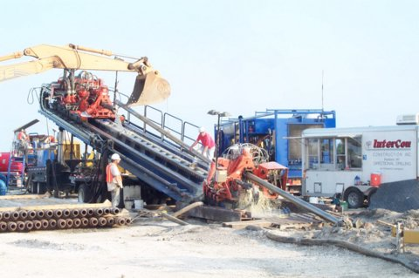

Slide 61
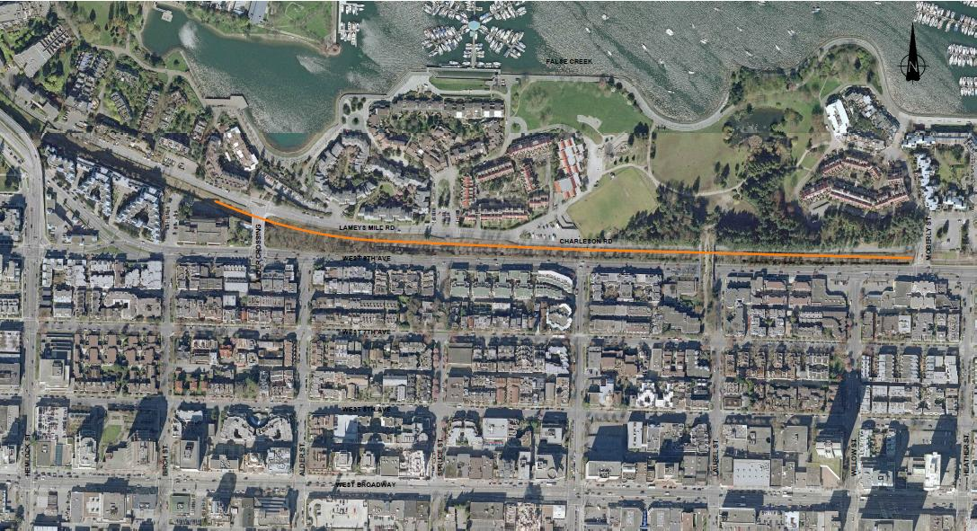
Pipe Fabrication and laydown on Railway Corridor
Pipe fabrication and laydown on railway corridor

Slide 62
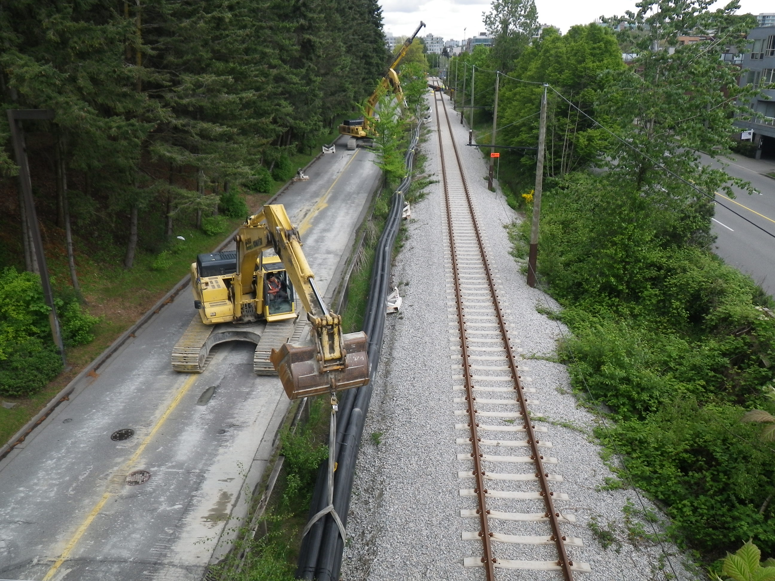

Slide 63
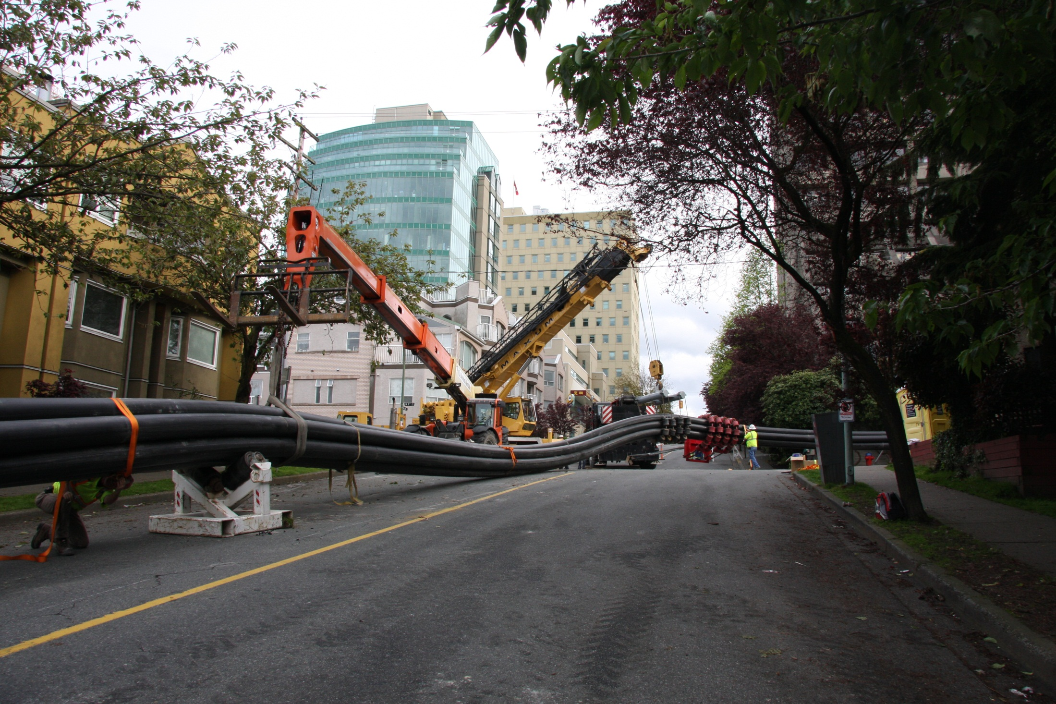

Slide 64
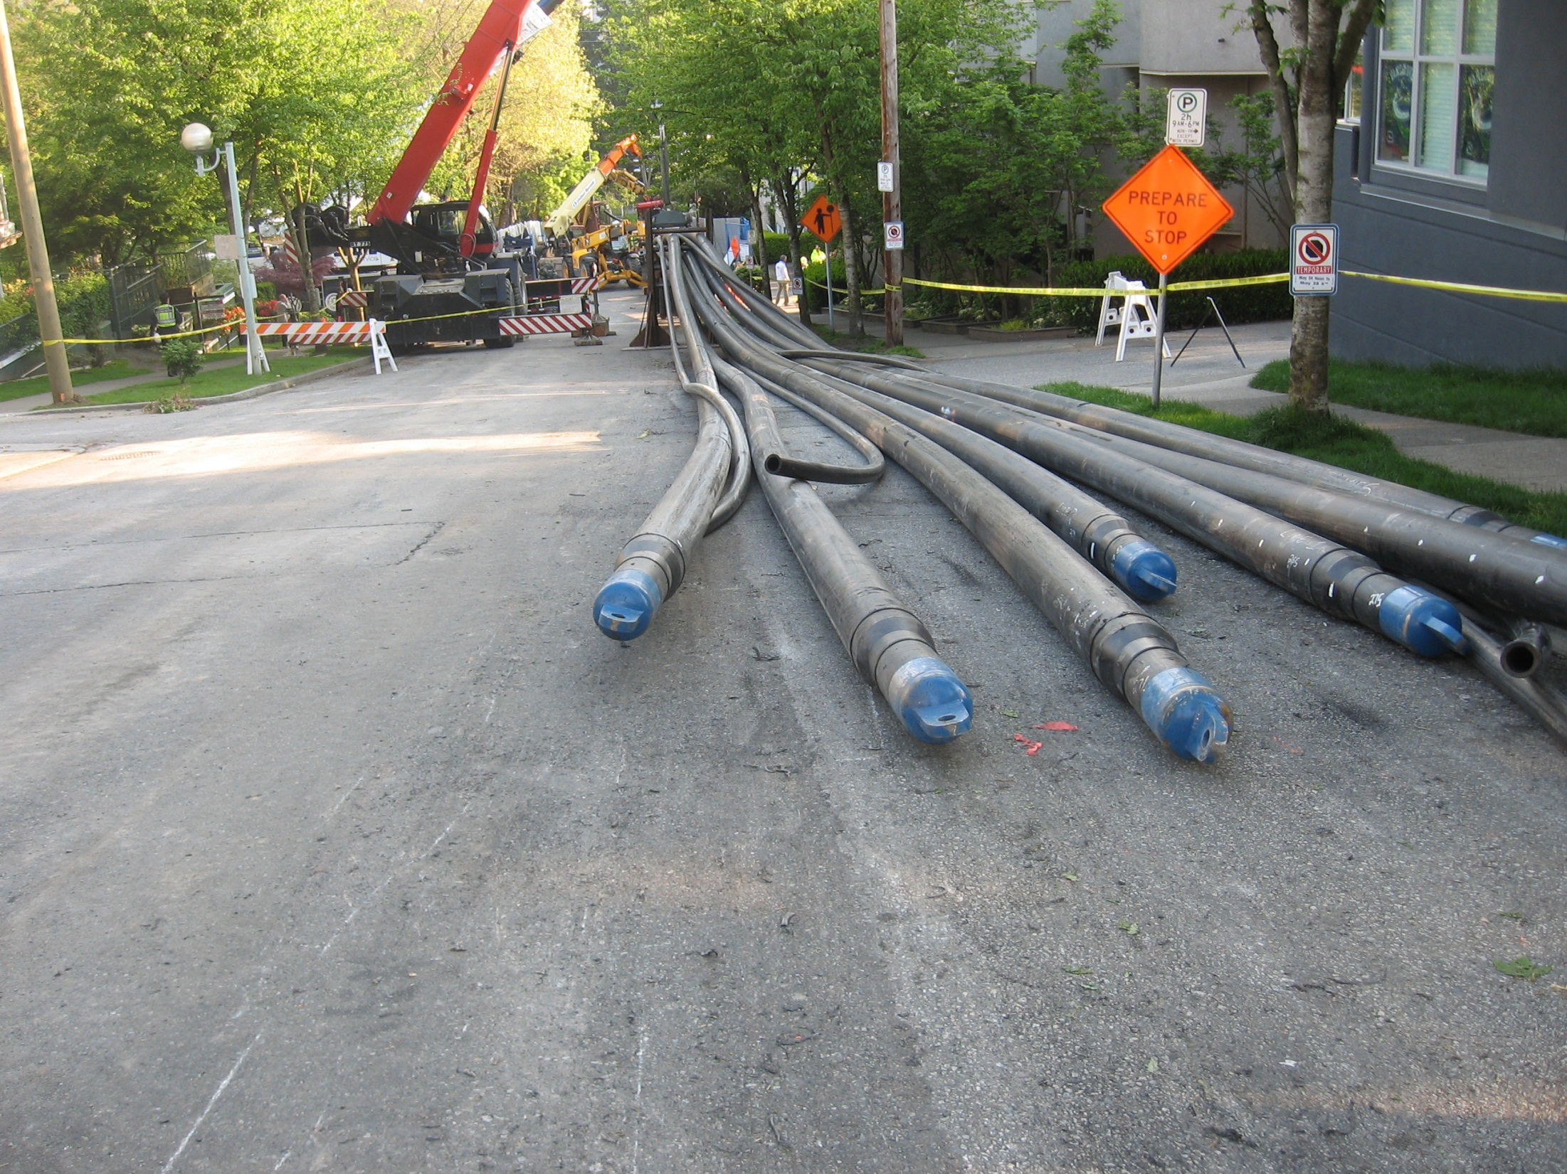

Slide 65
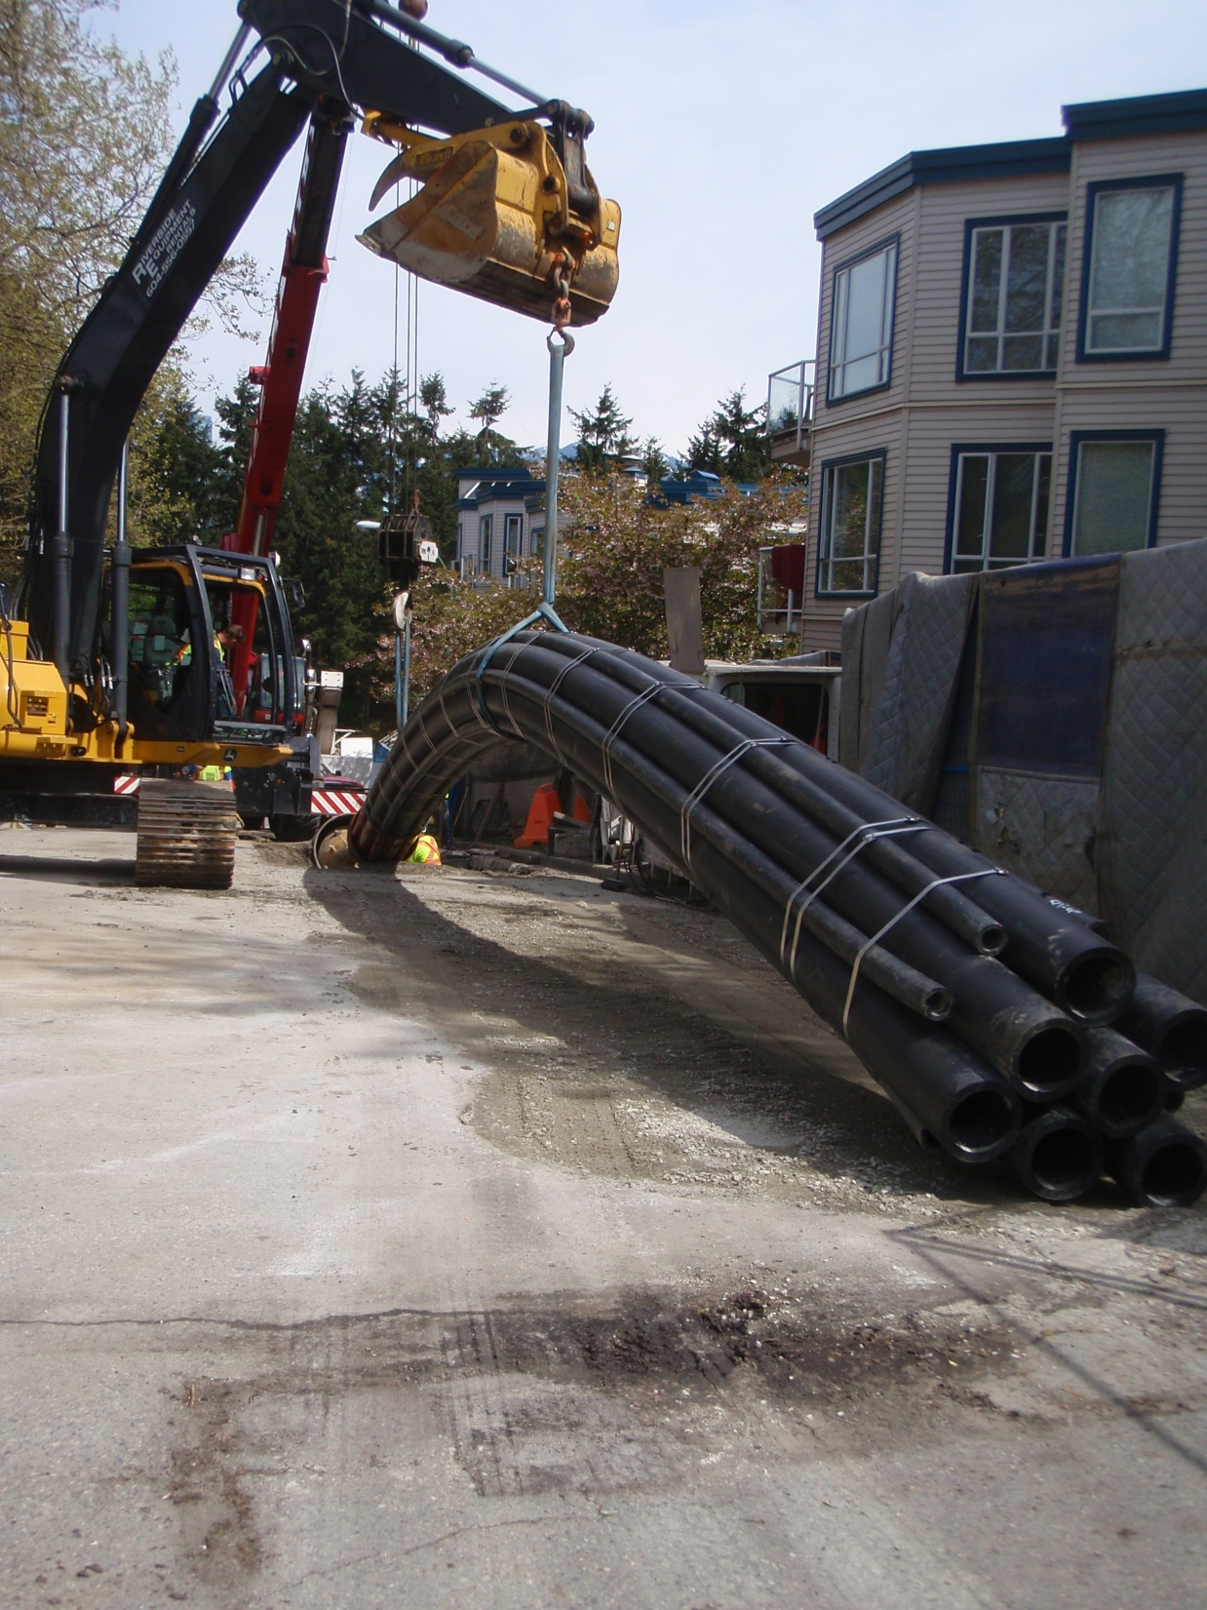

Slide 66
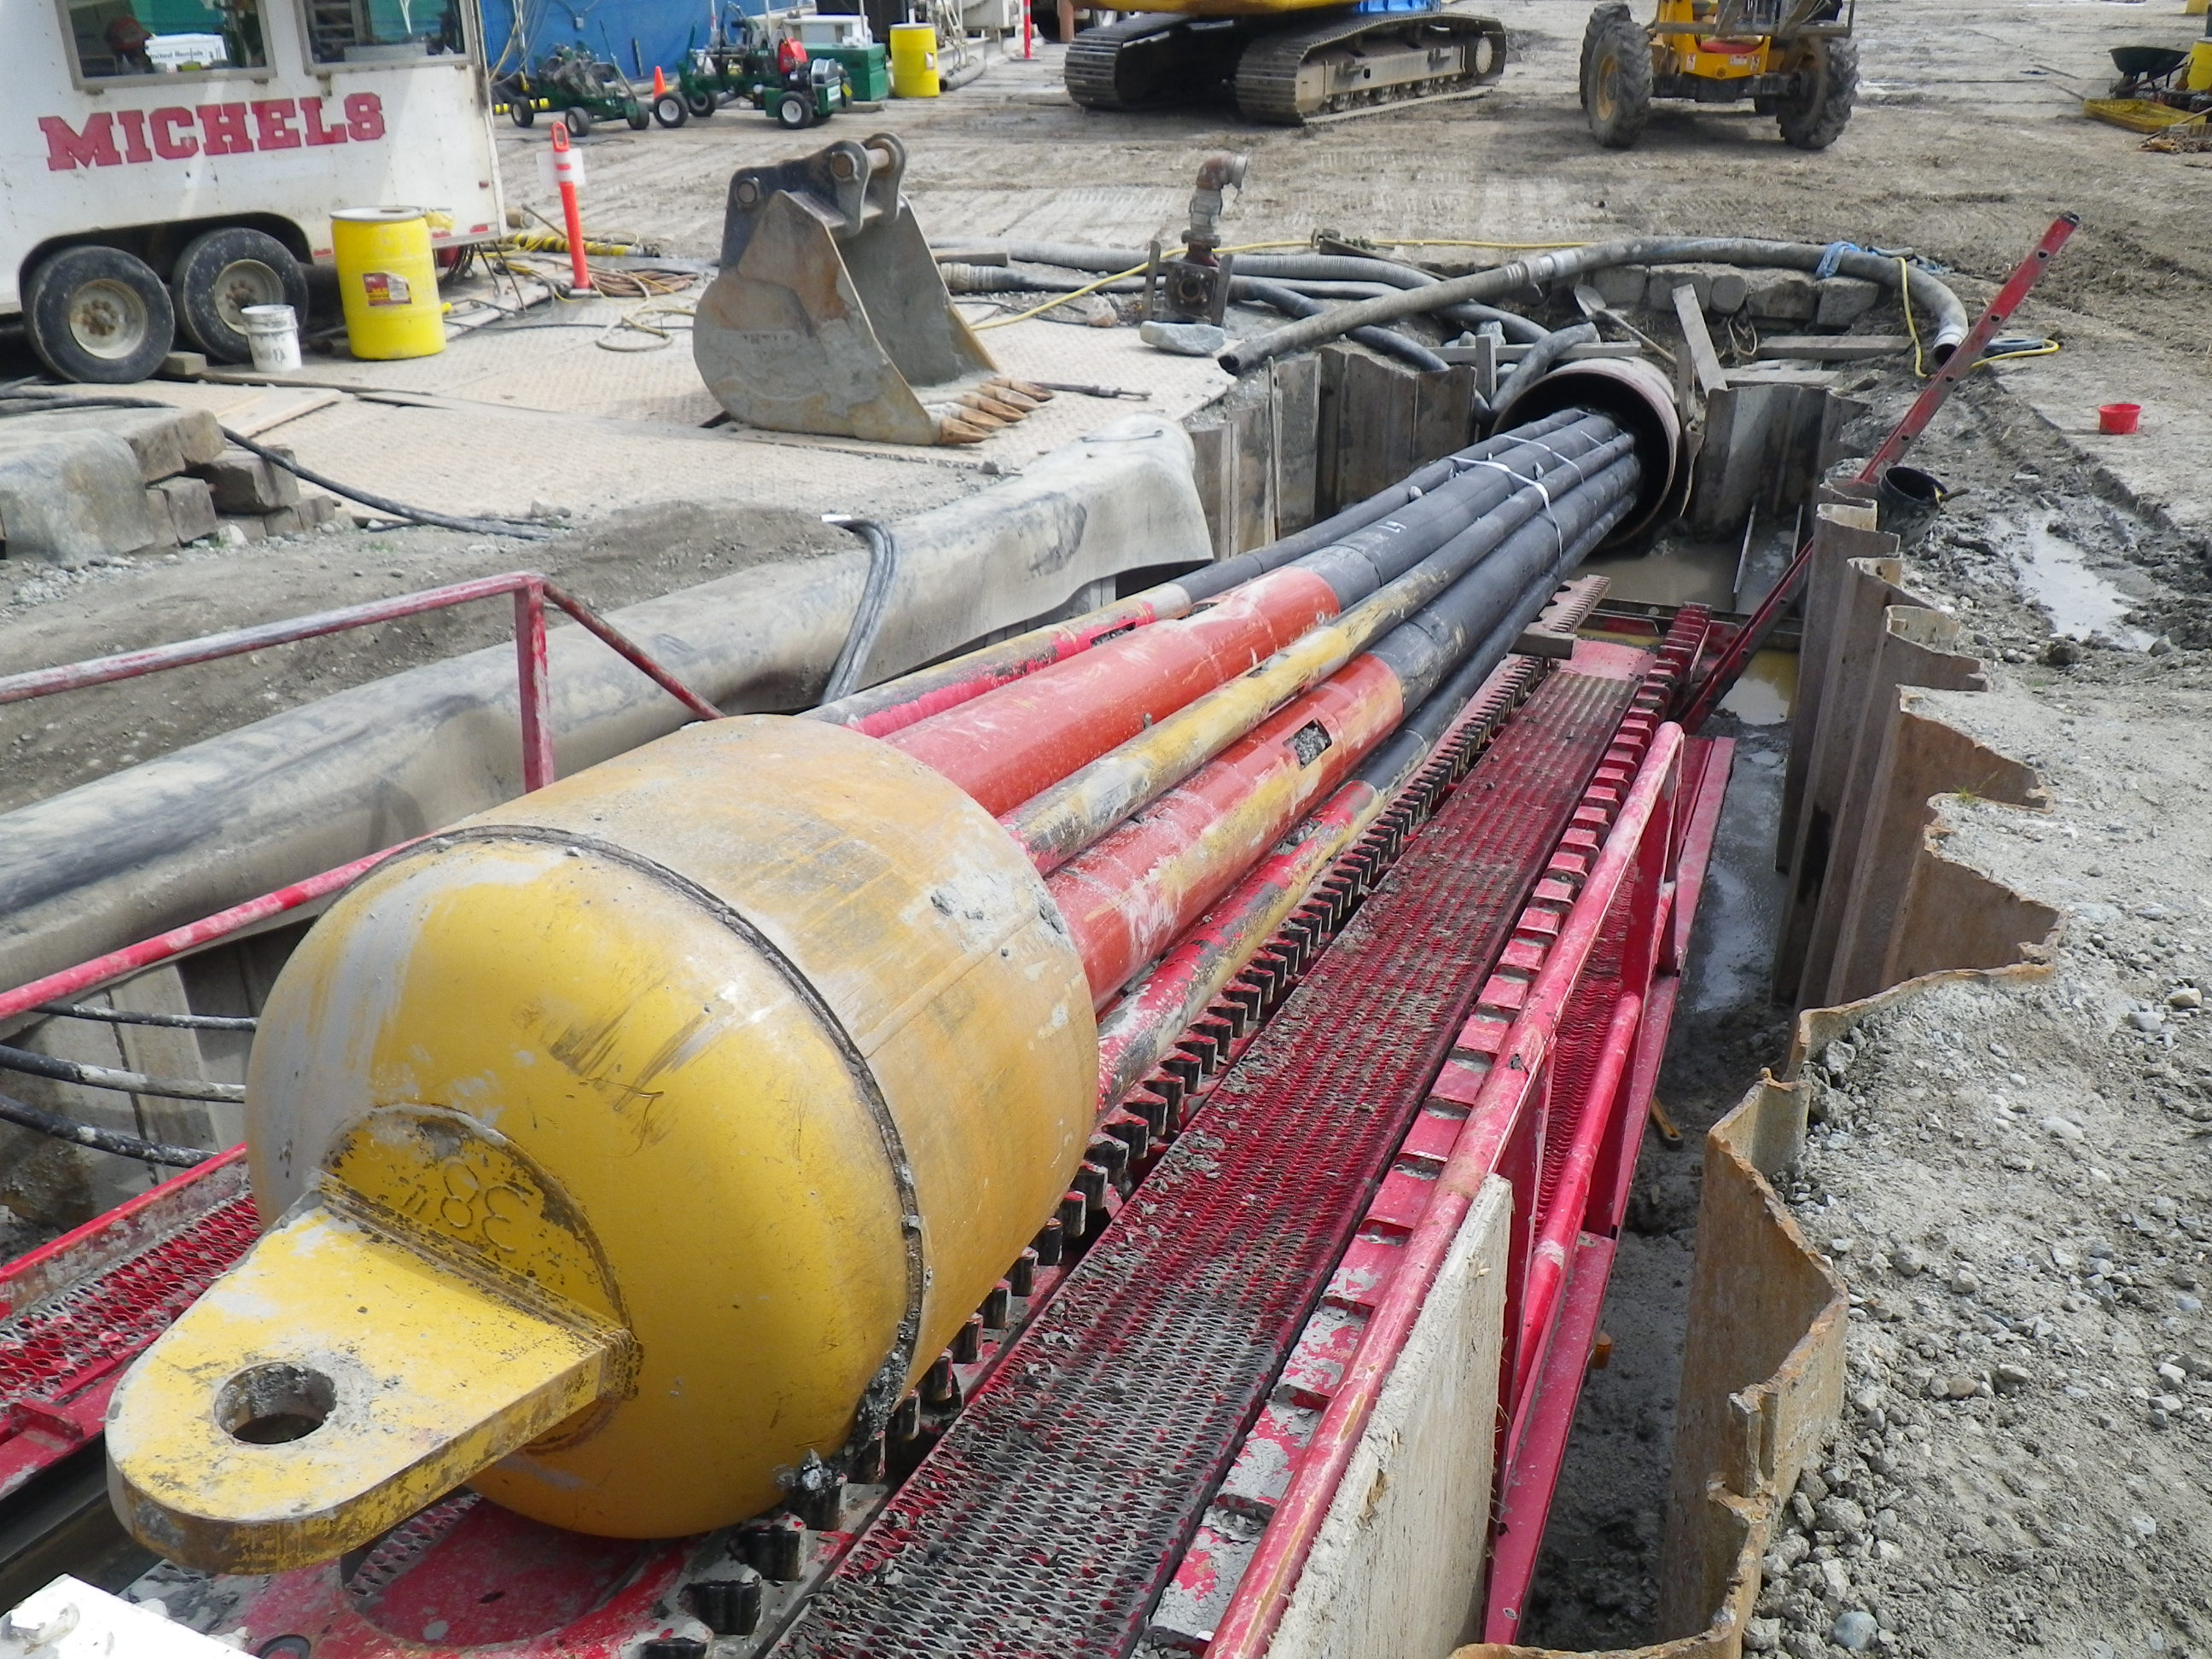

Slide 67
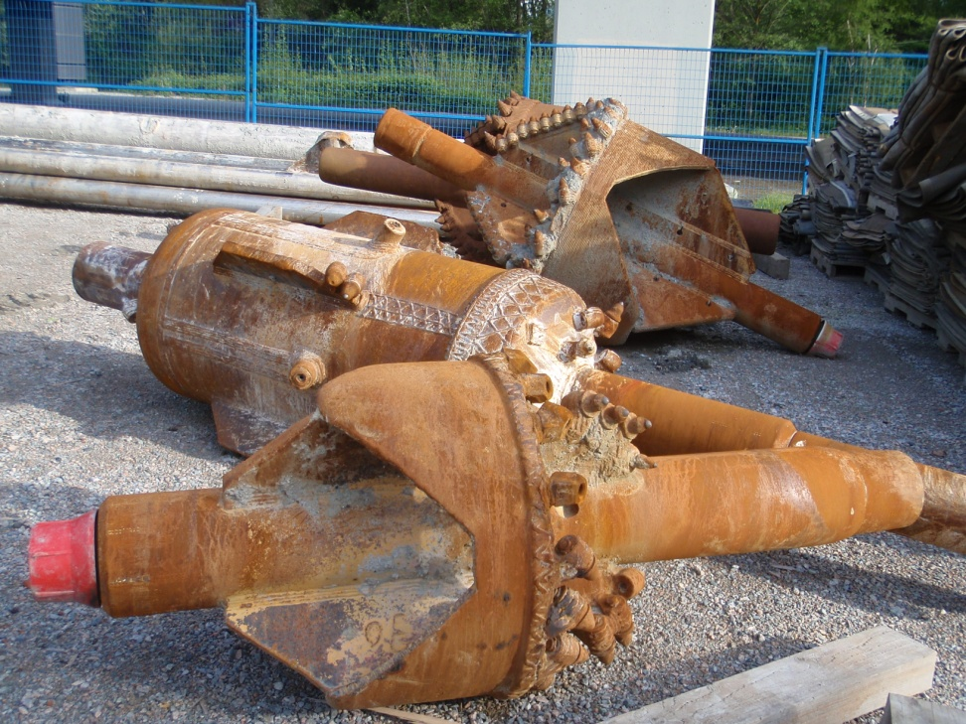
Reaming
Full size hole completed by two reaming passes;
The first ream upsized the pilot hole
to 750 mm from the 300 mm pilot hole;
The second upsized the hole to
1180 mm from the 750 mm.

Slide 68
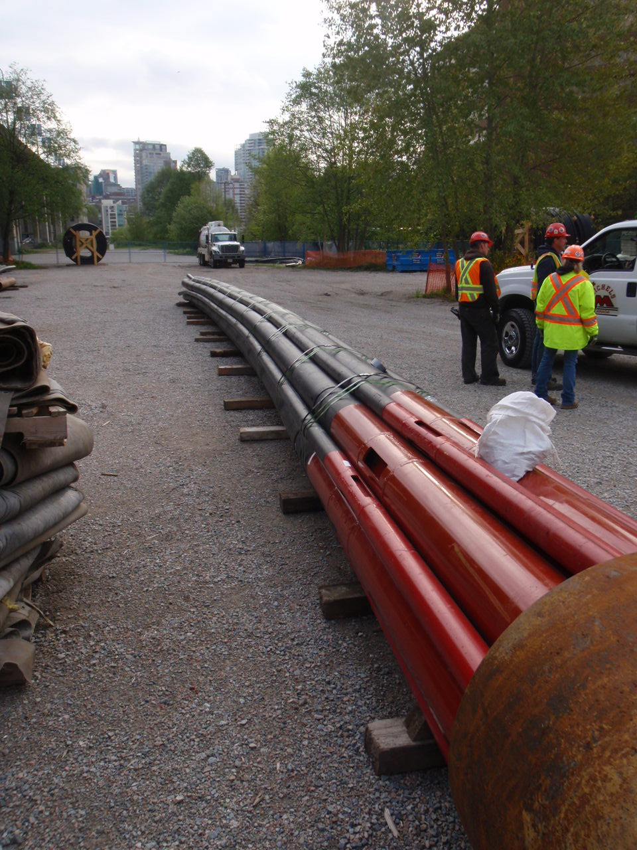
Pullback of Test Bundle
20 m long test bundle pulled through the borehole to ensure the borehole was clean and ready to receive the product bundle;
Test bundle pullback also yielded information on the performance of the bundle banding, prior to committing to installation of the actual product bundle

Slide 69
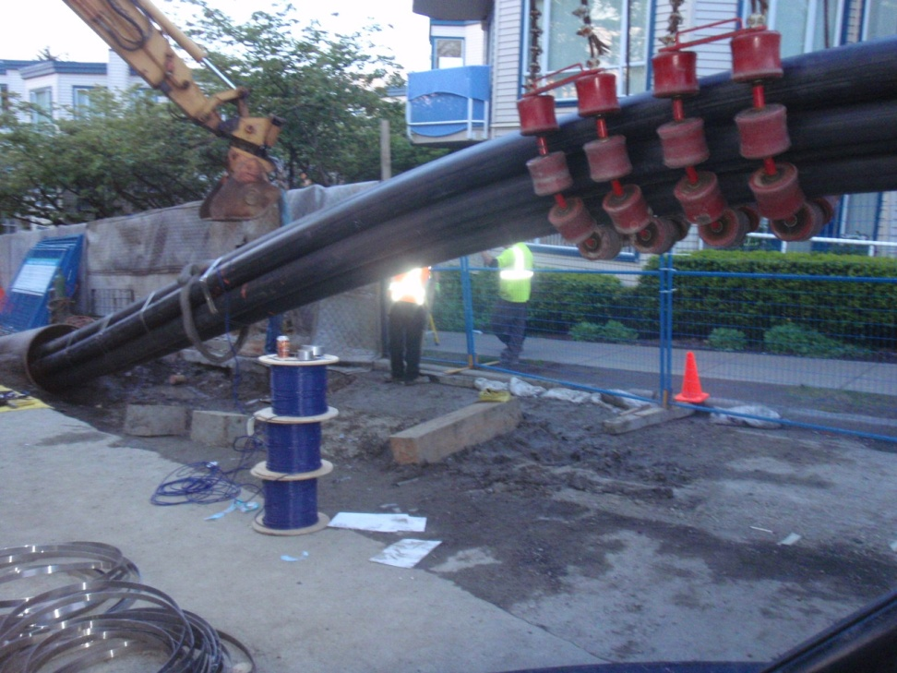
Pipe Pullback (continued)
As the HDPE product bundle was pulled into the hole, the bundle was strapped together using a
half-inch wide stainless steel strapping

Slide 70
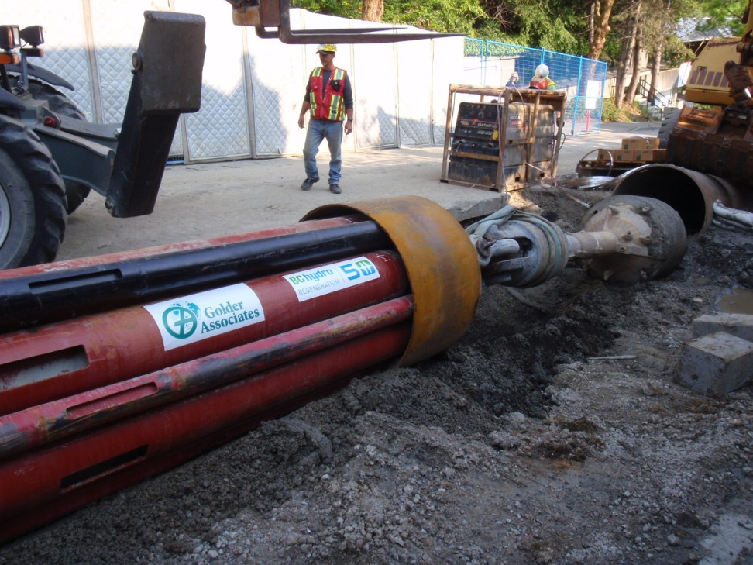
Pipe Pullback
Pullback started at 7 a.m. on May 29 and was completed on May 31 at
8 a.m.
Due to the length and geometry of the bundle layout, multiple pieces of heavy equipment worked in unison along with the pulling of the
drill rig

Slide 71
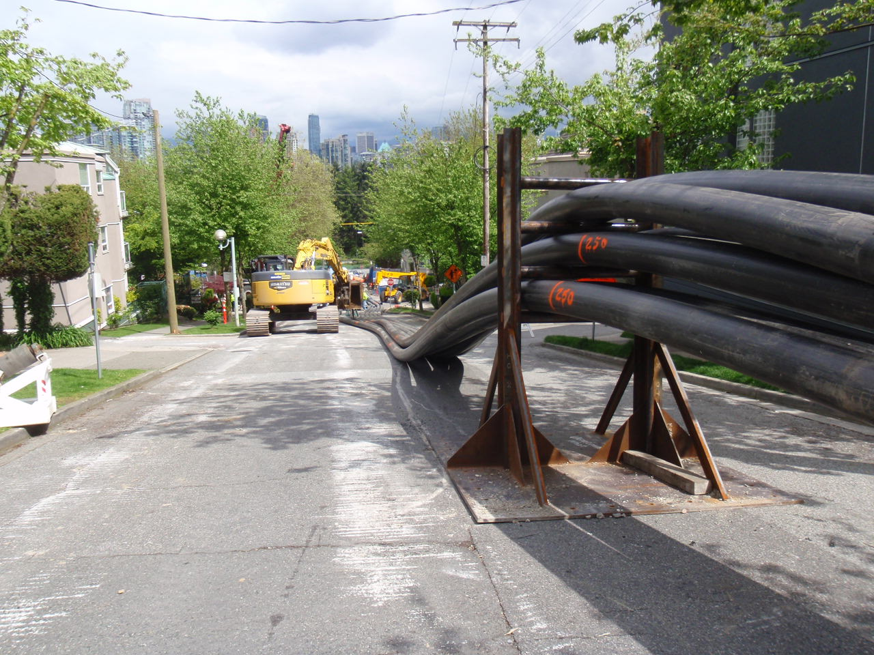
Pipe Pullback (continued)
In order to get the HDPE pipes into the proper configuration prior to entering the hole, steel jig were constructed to align the pipes in the correct order

Slide 72
Full Displacement Grouting
A total of four grout pours were needed to complete the displacement of the drilling fluids by the Thermal Grout
Pour #1 was the belly of the borehole – 157.9 cubic meters
Pour #2: South leg of the Borehole
– 89 cubic meters
Pour #3: North Leg to end of
60-inch casing – 106.5 cubic meters
Pour #4: North leg to grade – 60 cubic meters
Total of 413.4 cubic meters of grout pumped
9 2 percent displacement of the drilling fluid from the borehole achieved
Lab Testing provided onsite and at batch plant site. The test was taken prior to leaving the batch plant and prior to pumping on site by Metro labs
Thermal Resistivity (TR) testing on site by Powertech Labs

Slide 73
Public Impacts During
Pipe Move and Pipe Pullback
Closing off an area approximately 16 city blocks long by four blocks wide for five days
24 hour a day moving construction operation
Rerouted public transit services
Local residential traffic only in closed areas
Closing of underground parking garages for several apartment buildings
Obstructed direct access to local residences and businesses
Increased traffic flow along bypass routes
Restricted direct access for emergency services (Fire, Ambulance, Police)

Slide 74
Mitigation Measures
Emergency Services Response command center located on site – manned by City of Vancouver Deputy Fire Chief 24 hours a day.
Implementation of 20 City of Vancouver Police officers and traffic Authority officers to assist with traffic control
Advanced notification of closures city wide via media (BC Hydro facilitation via TV, radio, email and mailings)
Implemented a shuttle bus service 24 hours a day to move residents in and around the HDPE product bundle as it moved through the city streets (three separate routes)
Shuttling around elderly and carrying groceries as needed throughout the process

Slide 75
